Slide 1

NutriHealth
AI Chatbot
Done by Anish, Richard, Poh Yee, Sammi
Group Name: ARPS

Slide 2
Table of contents
01
02
03
04
Background
Problem Statement
About Problem
Target Market
Introduction to problem statement
Goals and Solution
Achieving of the goals
Ideation
Demo and QnA
Development Stage
Wireframe
Features
Demo of AI Chatbot
Question and Answer

Slide 3
01
Background
About Problem, Target Market

Slide 4
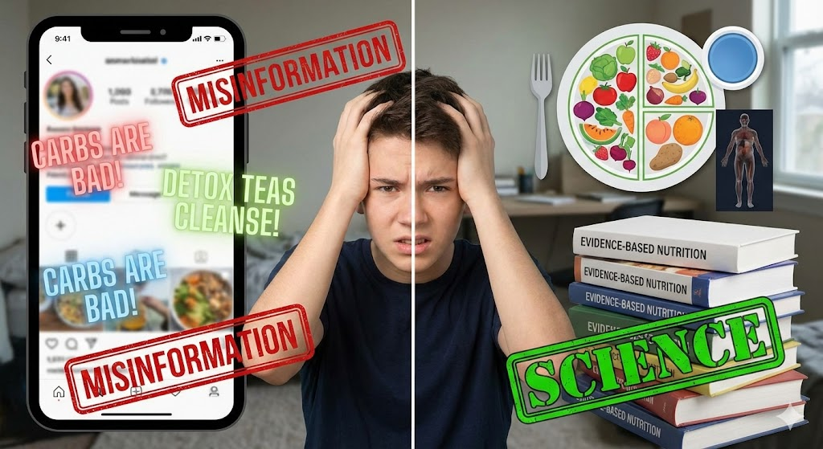
About Problem
The Problem
Social media spreads fast, widespread nutrition misinformation.
Viral trends (e.g., “carbs are bad”, “detox teas cleanse your body”) overshadow scientific facts
Conflicting advice leaves people confused, misinformed, and frustrated
Hard for non-experts to identify what is evidence-based vs. misleading

Slide 5
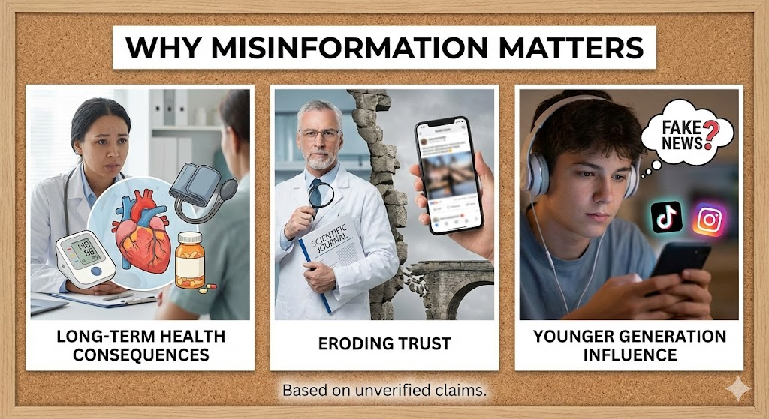
About Problem
Why This Matters
Poor food choices lead to long-term health consequences (obesity, nutrient deficiency, chronic disease risk)
Misinformation erodes trust in credible nutrition sources
Younger users (TikTok, Instagram) are most influenced by unverified claims

Slide 6
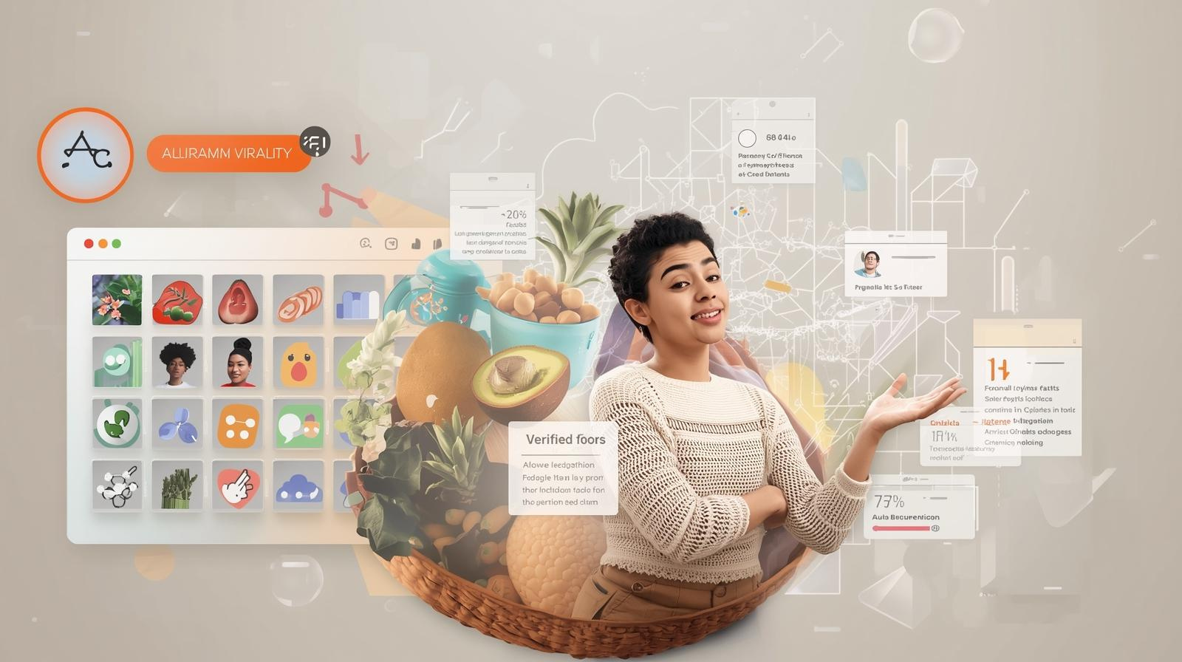
About Problems
Why This Problem Exists
Algorithms prioritise virality over accuracy
Influencers share personal opinions as “truth”
Attractive visuals & aesthetics
Nutrition is complex
No easy way for users to verify claims

Slide 7
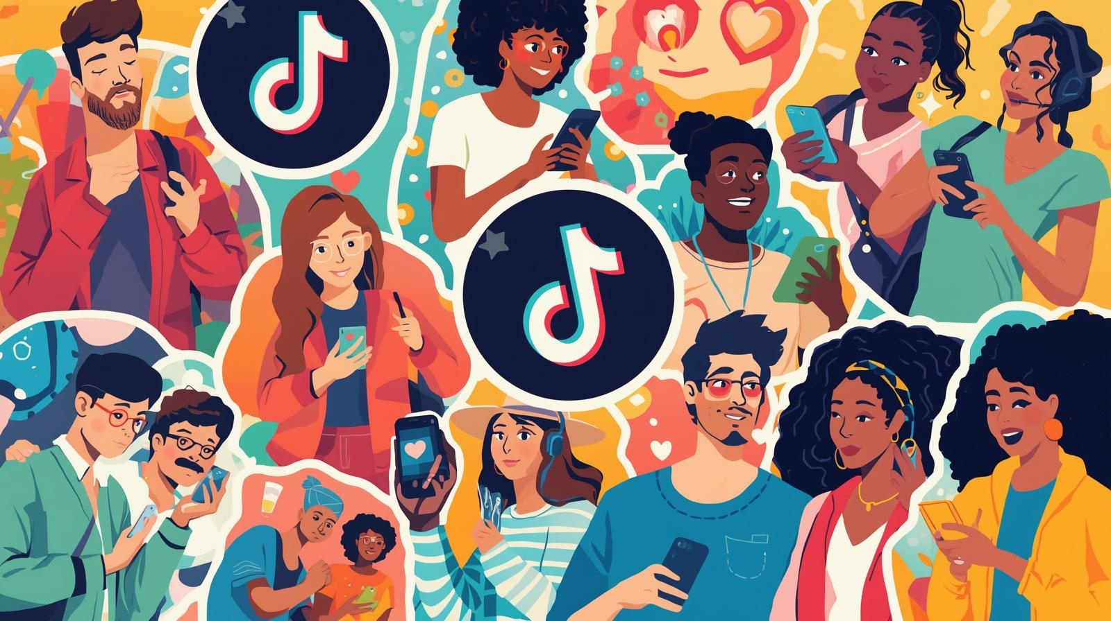
Target Market
Young Adults (18–30 years old)
Individuals Trying to Improve Their Diet
Busy Students & Working Professionals
Beginners With Low Nutrition Knowledge

Slide 8
02
Problem Statement
Introduction to problem statement, Goals and Solution, Achieving of the goals

Slide 9
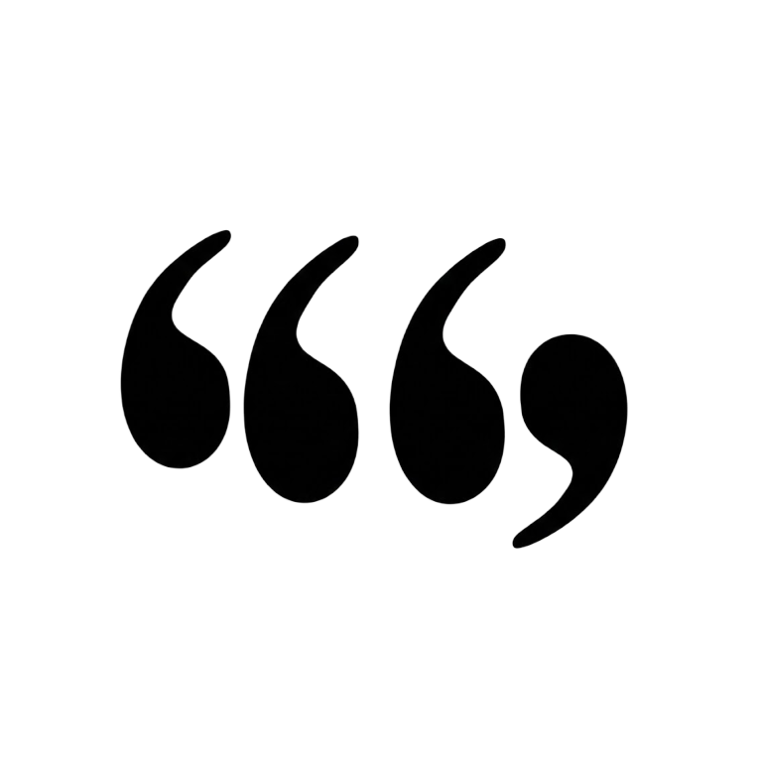
Introduction to the Problem Statement
Social media is flooded with conflicting and unproven diet trends, making it hard to know what's actually healthy. Viral myths like "carbs are always bad' or "detox teas cleanse your body' spread quickly, while evidence-based nutrition advice often gets overlooked. This misinformation leads to unhealthy eating habits, wasted money on fad products, and potential long-term health consequences.

Slide 10
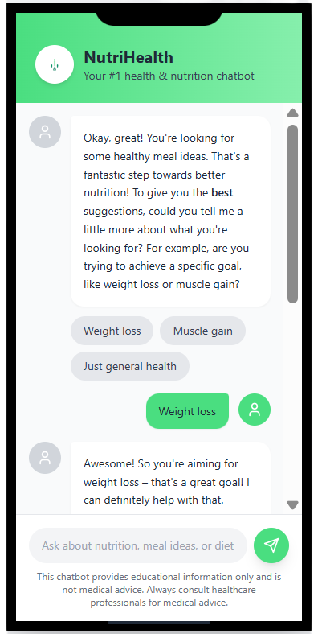

Goals and Solution
Our Solution
Provide clear, scientifically validated answers to user questions
Tailor advice to younger people based on their goals and dietary preferences
Detect and correct common viral myths using a curated knowledge base
Offer simple, actionable guidance instead of confusing mixed messages

Slide 11
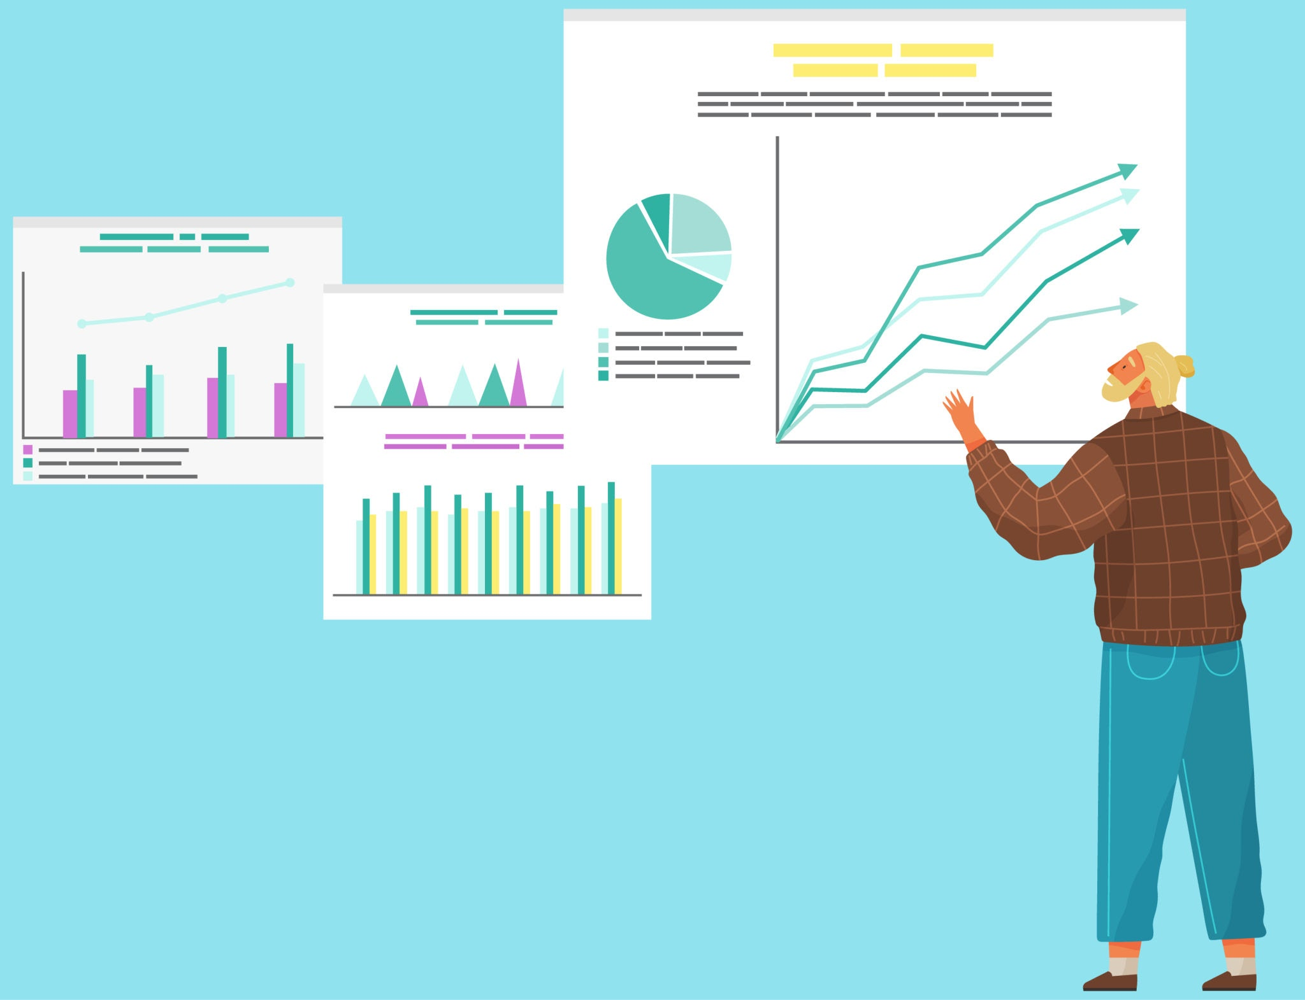
Goals and Solution
How We Achieve This
Combine rule-based logic with structured nutrition data
Use a myth-detection system to identify misinformation patterns
Personalise responses using user profiles (goals, restrictions, lifestyle)
Present information in friendly, digestible, non-technical language

Slide 12
03
Ideation
Development Stage, Wireframe, Features

Slide 13
Tech Stack
React + Vite
Lucide-React Icons
Tailwind CSS
Marked.js
Sealion API

Slide 14
Timeline (D1-D4)
Day 1
Day 2
Day 3
Day 4
Discussion & ideation
Basic wireframing
Finalise wireframing
Basic frontend layout
Basic backend framework
Polish backend framework
Implemented backend API to frontend
Polish UI/UX

Slide 15
Timeline (D5-D7)
Day 5
Day 6
Day 7
Added sidebar feature for better user experience
Improved conversation flow
Integrated sidebar with backend
Worked on presentation slides
Did final product testing
Finalise slide
Submit web app

Slide 16
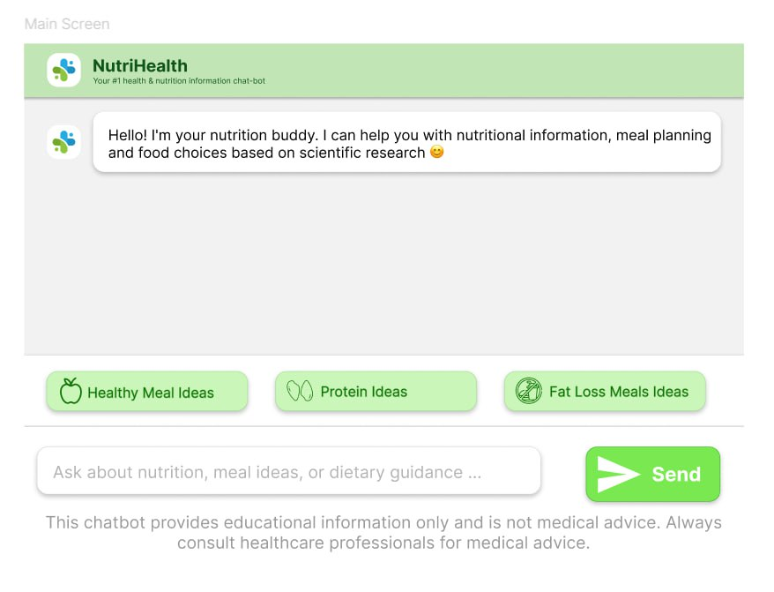
Wireframe
Rough figma mockup

Slide 17
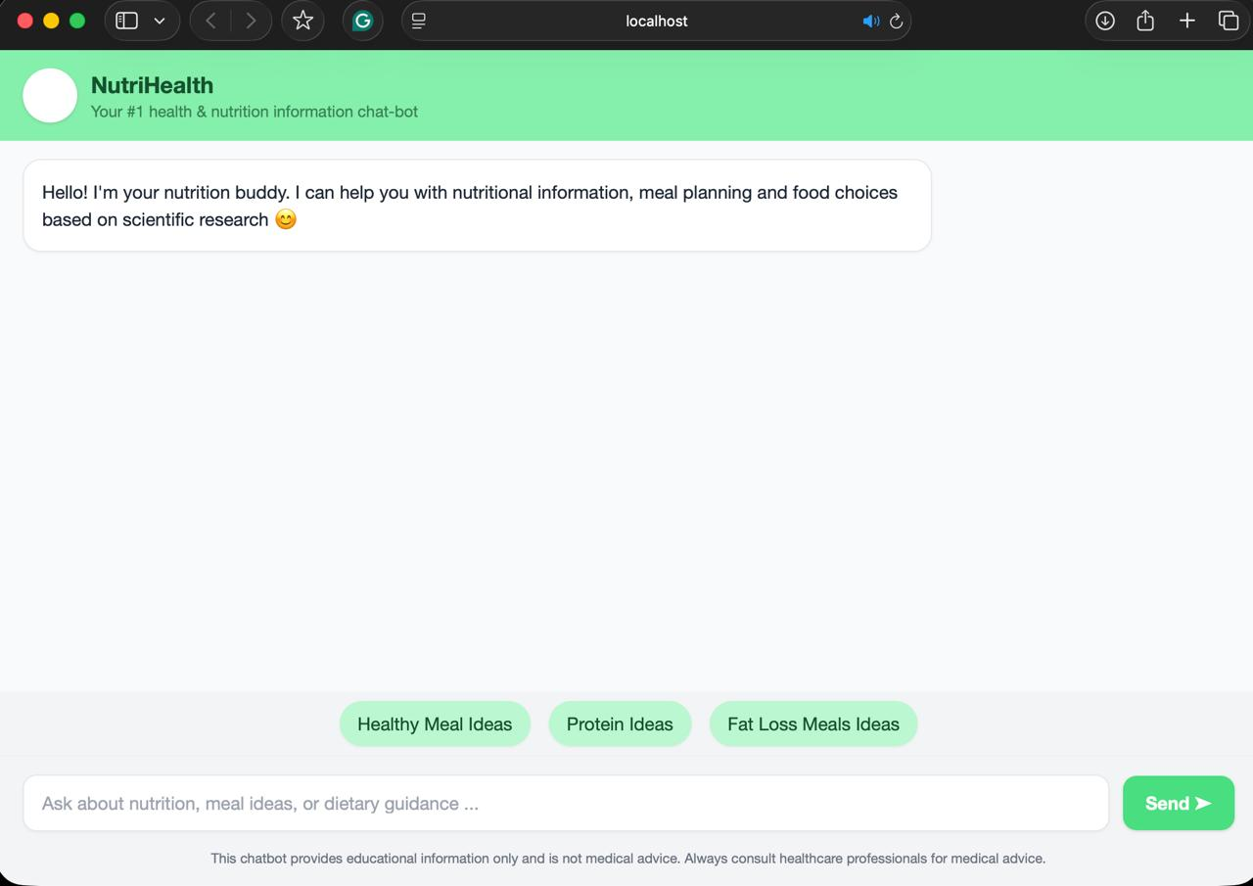
Wireframe
Basic iteration

Slide 18
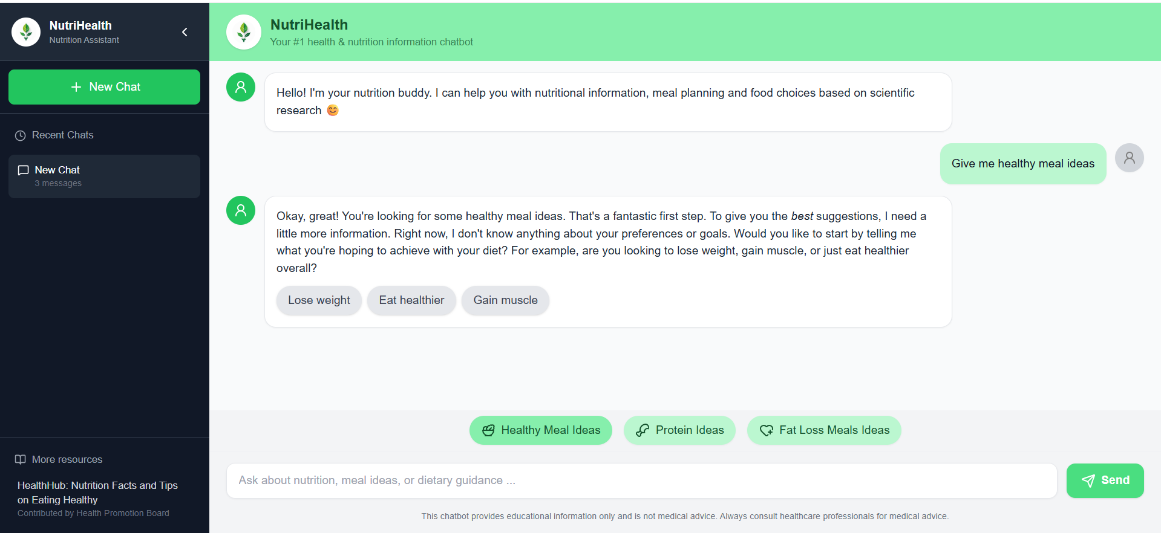
Wireframe
Final polished wireframe

Slide 19
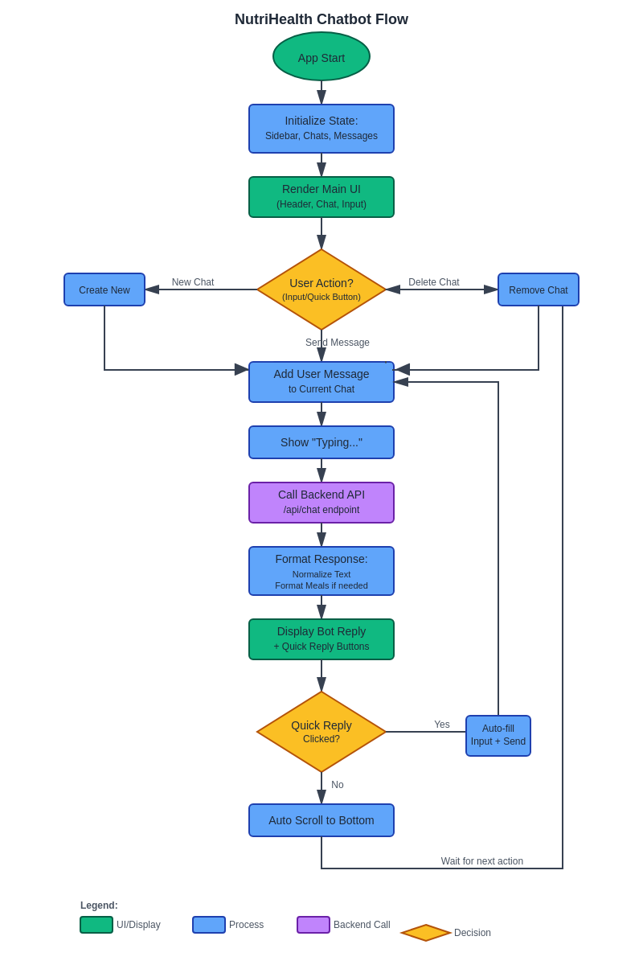
Flowchart

Slide 20
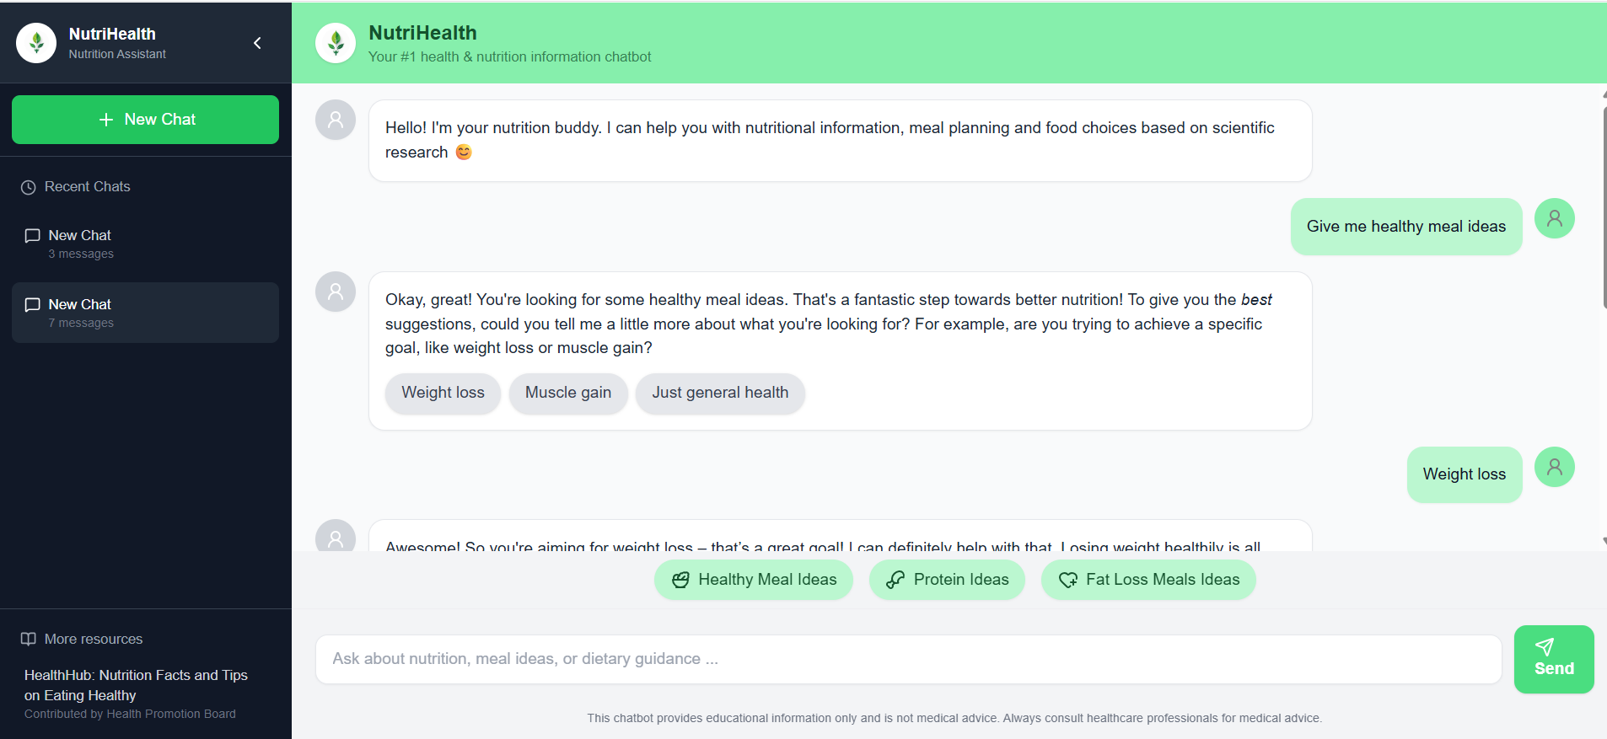
Features
1
2
3
Chat system
Sidebar Tabs
Conversation Management
Send and receive messages in real time
Bot typing indicator
Auto-scroll to newest message
Markdown support for formatted responses
Custom smart meal formatting
New Chat
Chat History
Extra resources
Start new chat sessions
Switch between multiple chat sessions

Slide 21
Features
4
5
Smart Chat UI
Backend Integration
Clean, responsive layout with TailwindCSS
Avatars for bot & user
Quick reply buttons for guided prompts
Smooth transitions & organized layout
Connects to AI model API for generating responses
Secure request/response handling between frontend & server
Context management for multi-session conversations

Slide 22

04
Demo & QnA
Demo of AI Chatbot, Questions and Answers

Slide 23

Thanks!
Please keep this slide for attribution

